Slide 1
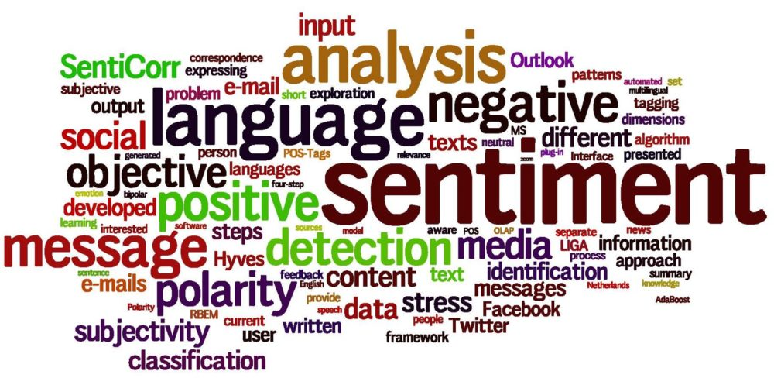

Slide 3
CSV file of crawled tweets
Preprocessing of tweets
Remove URLs
English Dictionary Creation
Extraction of words
Stemming
Twitter Handle Scrapper
Generation of Sentiment Metric
Vader Sentiment Analysis
WORD CLOUD GENERATION
Text file containing preprocessed word set

Slide 4
Sentiment Metric | Score
Positive
Negative
Neutral
Compound

